Slide 1
SaferBraIn - Final Meeting – Vulnerable Road Users and the Traffic Safety Problem in Brazil
Eng.Hugo Pietrantonio, D.Sc. Department of Transportation Engineering
Escola Politécnica – University of São Paulo, Brazil

Slide 2
SaferBraIn – VRUs of Brazil
Goal: - review the basic features of the road safety problem in Brazil and its impact on vulnerable road users (VRUsers) especially ...
- discuss features of the VRUs´ safety problems in Brazil, perhaps conditioning approaches that can be effective in reducing the current burden!
Basics on Road Safety in Brazil
Vulnerable Road Users in Brazil
Vulnerable Road Users in Sp
Constraints and Difficulties

Slide 3
road Safety Problem in Brazil: basic information

Slide 4
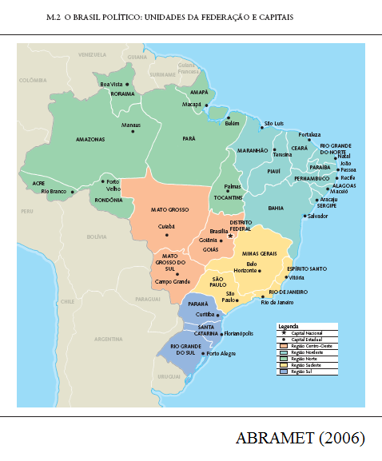
Brazil: Administration and Regions
Nominated as Federal Republic, i.e. a country constituted by states, but a highly centralized administration
- 1st exception: its major state ... State of São Paulo: 1/5 pop; 1/3 prod; -2nd exception: its major city ... City of São Paulo: 1/20 pop; 1/9 prod; - other exceptions: several capitals of states, medium-sized cities ...
Regional disparities are large: - North: large area, low density mainly undeveloped; Amazonia - Center(Mid)-West: similar; Cerrado - North-East: populated and poor - South-East: richiest (SP, RJ, ...) - South: second but similar ...

Slide 5
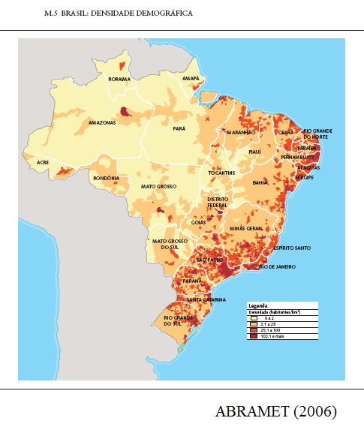
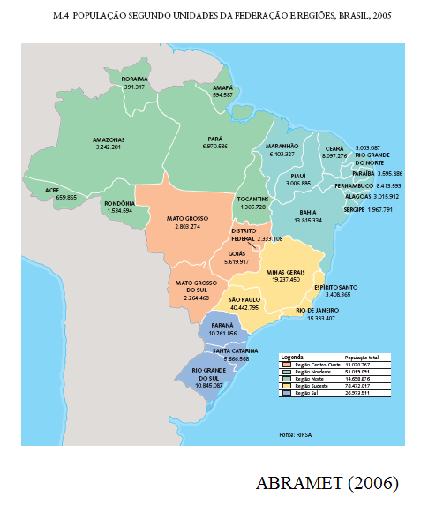
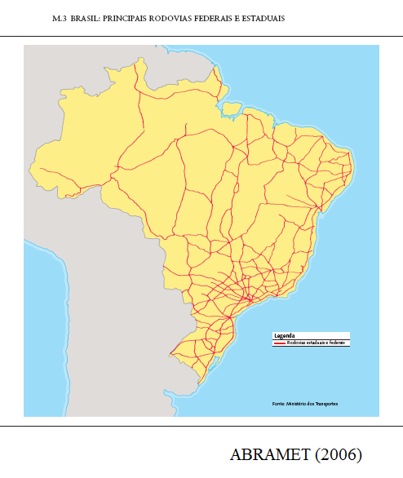
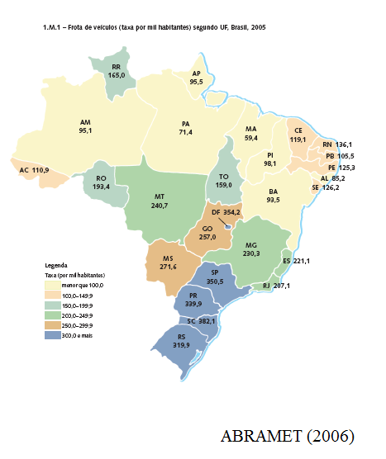
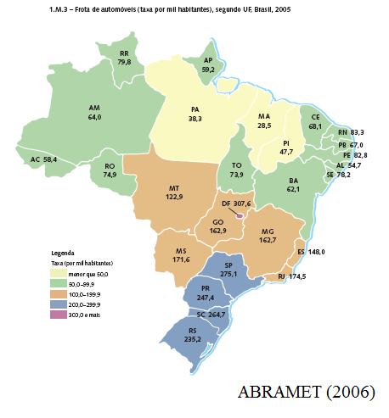

Slide 6
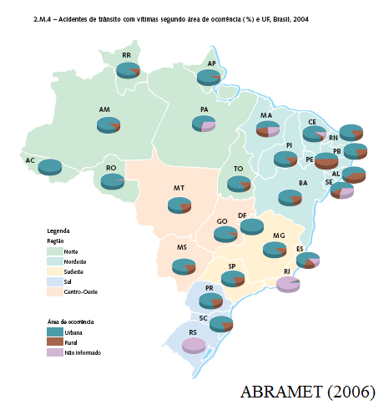
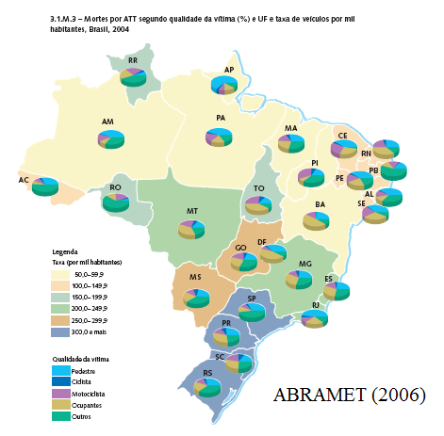
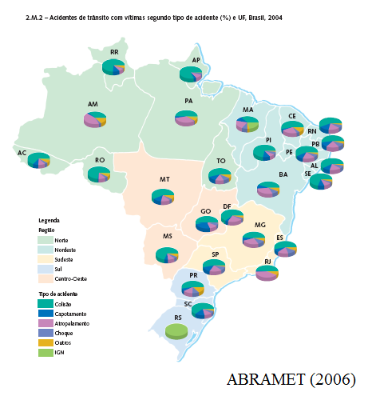

Slide 7
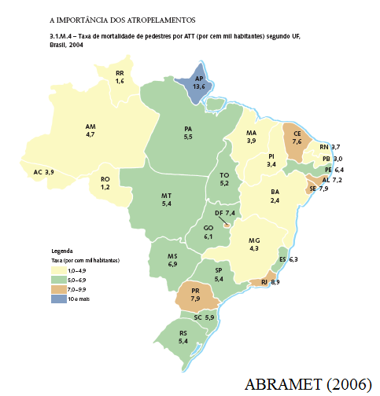
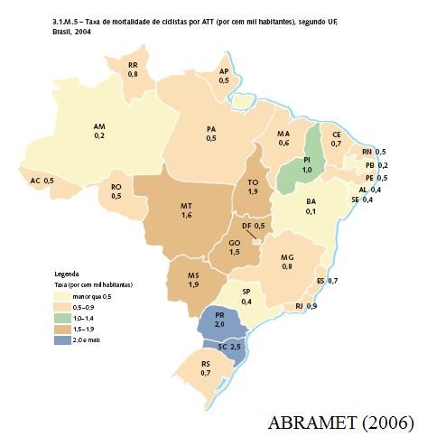
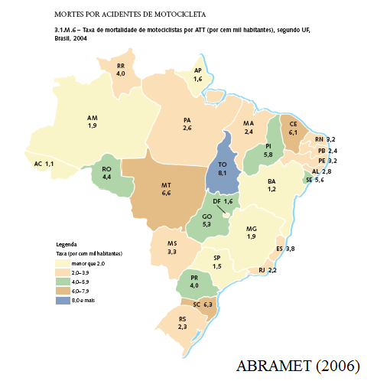
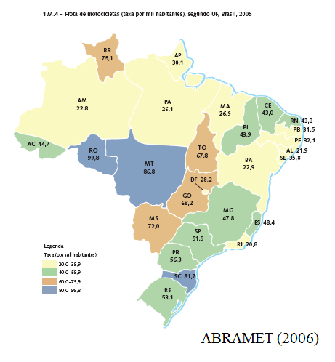

Slide 8
The National Traffic System (SNT-Sistema National de Trânsito)
Levels: Country, State, City ...
Areas: Traffic, Policing, Highway ...
Union: general rules and coordination; Contran-National Traffic Commission (under the Ministery of Cities ; before Ministery of Justice ... Transport ...)
State: licensing (drivers, vehicles)
Local bodies and Highway agencies: circulation on roads under their rules
Enforcement dispersed among levels and areas; exerted by own agents or delegated to other police bodies ...
Administrative justice also (JARIs ...)
Traffic | Policing | Highway | Other
Contran Denatran | PRF | DNIT ANTT | Justice
Cetran Detran | ... PMs ... PCs | DERs ARTEs | Justice
Local Authorities (*), GMs, ... (Sp: DSV, CET, ..., under SMT ...) |  |  | ...
JARI: 1st level of administrative recourse (2nd level of recourse is Cetran or Contran)
* Cities have to organize its bodies and gain approval from Cetrans, before acceptance * Complementary: CFCs (training of drivers), CMs (medical and psycho), OIs (inspection) ...
Norms:
highways
The judicial process is a major problem!
roads

Slide 9
Data on Traffic Accidents and their Victims
Data sources: 3 main (weak) sources - from Police to DENATRAN, including PDO, injury and fatal accs, as gathered by SNT bodies ... - from Hospitals to DataSUS, only for injuries and fatalities ... - from Mandatory Insurance, when DPVAT coverage is reclaimed ...
Example: Fatalities in 2005 - Denatran: 26.409 deaths ... 25.342 - DataSus: 35.994 deaths ... 34.381 - SegDpvat: 50.953 deaths ... 39.179
For 'serious' bodies, local databases are usually much better and uniform
Renaest Denatran
DataSus M.Health
Insurance Lider
Traffic Bodies
Hospitals LegalMed
Insurance Agents
Police Records
Record of Inpatients
Reclaiming by Offended
Traffic Accident

Slide 10
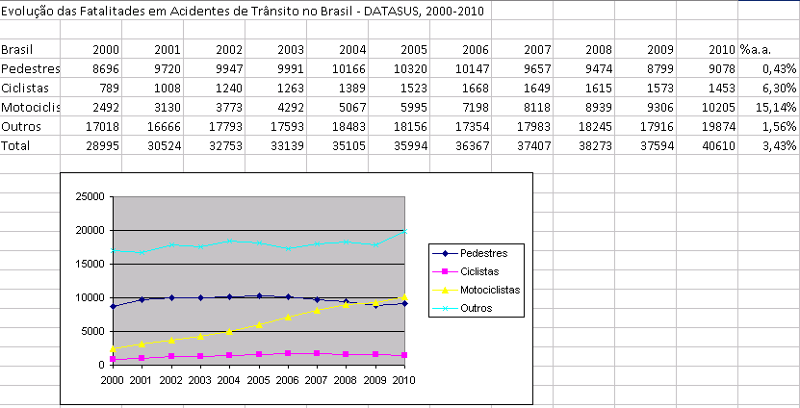
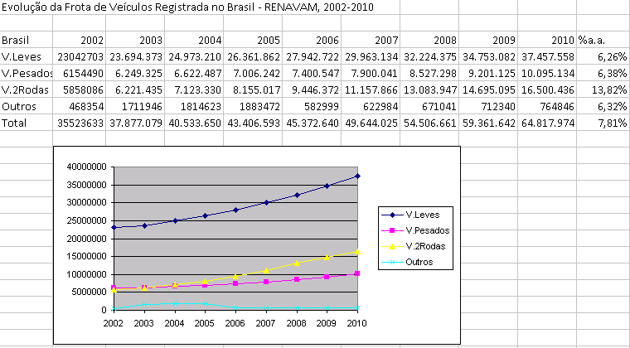
Accident Data: is there a trend?
Major (recent) events: - 1990 and after: dissemination of electronic enforcement ... - 1998: new code (CTB) effective ... (even if not fully efficient ... but progressive licensing, punctuation of driver offenses, increased fines, a national fund for traffic education ...) - 2005 and after: increased enforcement of drink&drive law ... (several trials ... the last in 2011 ...) - large pressure for bureaucratic 'safety' actions (mandatory equipments, mandatory inspections, ... and other rent seeking biz ...)
Source: DATASUS; DENATRAN: change of data collection-RENAEST

Slide 11
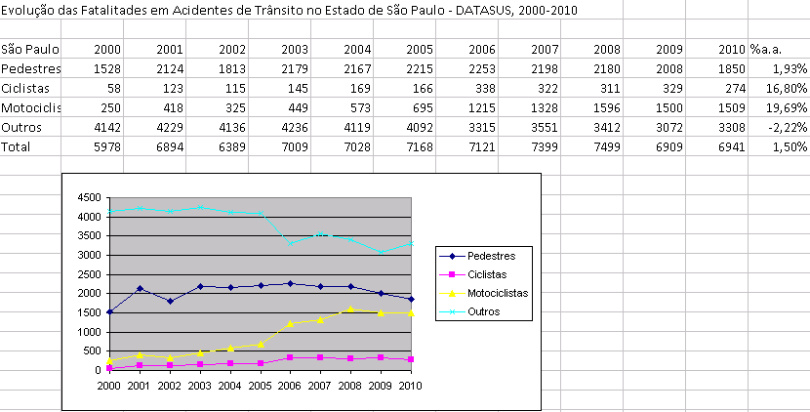
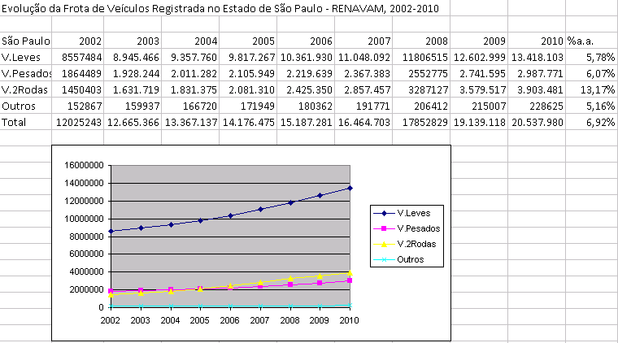
What can make the Brazilian Traffic Safety Problem peculiar?
Weak coordination at the national level ... No targets, no evaluation ...
Institutional differences are clear but their conditioning effect is not: - dependence on enforcement ... - dependence on physical actions (failure of the judicial system) ...
Dynamic factors are also a major difference: rate of chance is much higher ... new developments are widespread around cities and "rural" areas (major and minor ones) ...
Last, but not least (as usual): “poverties” are a constraint ... but mostly inequalities are noticeable and their effects have to be taken!

Slide 12
road Safety Problem in Brazil: POSITION OF VULNERABLE USERS AND THEIR accidents

Slide 13
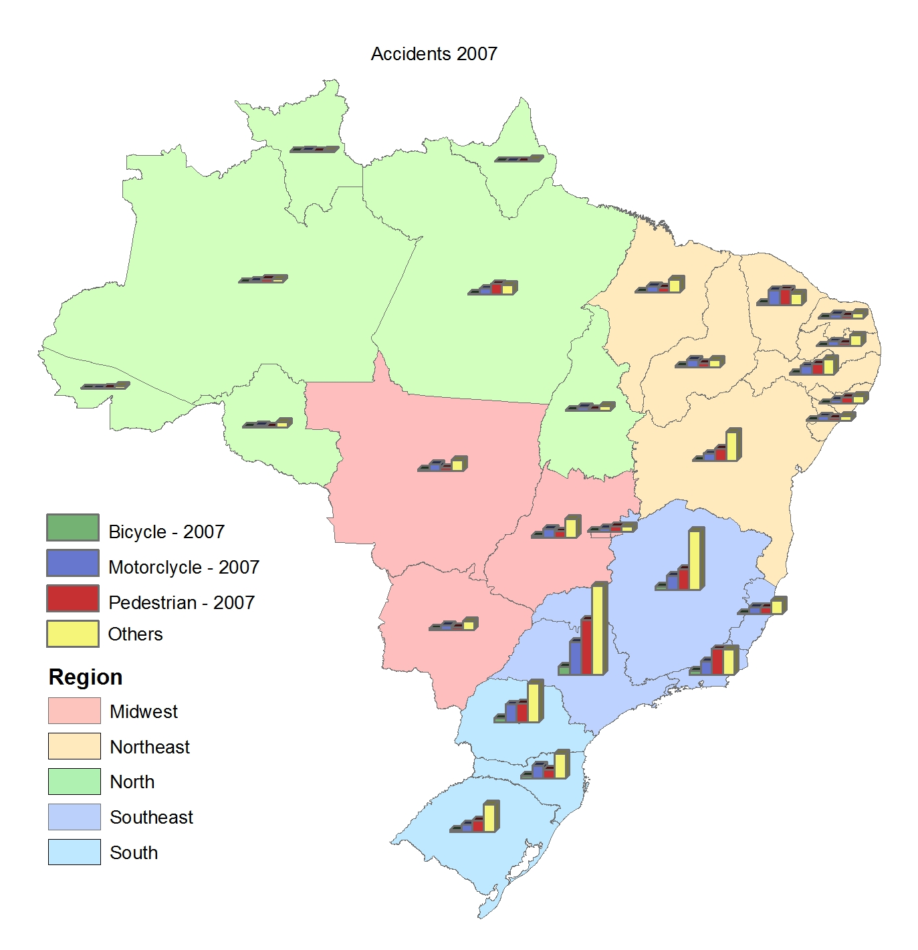
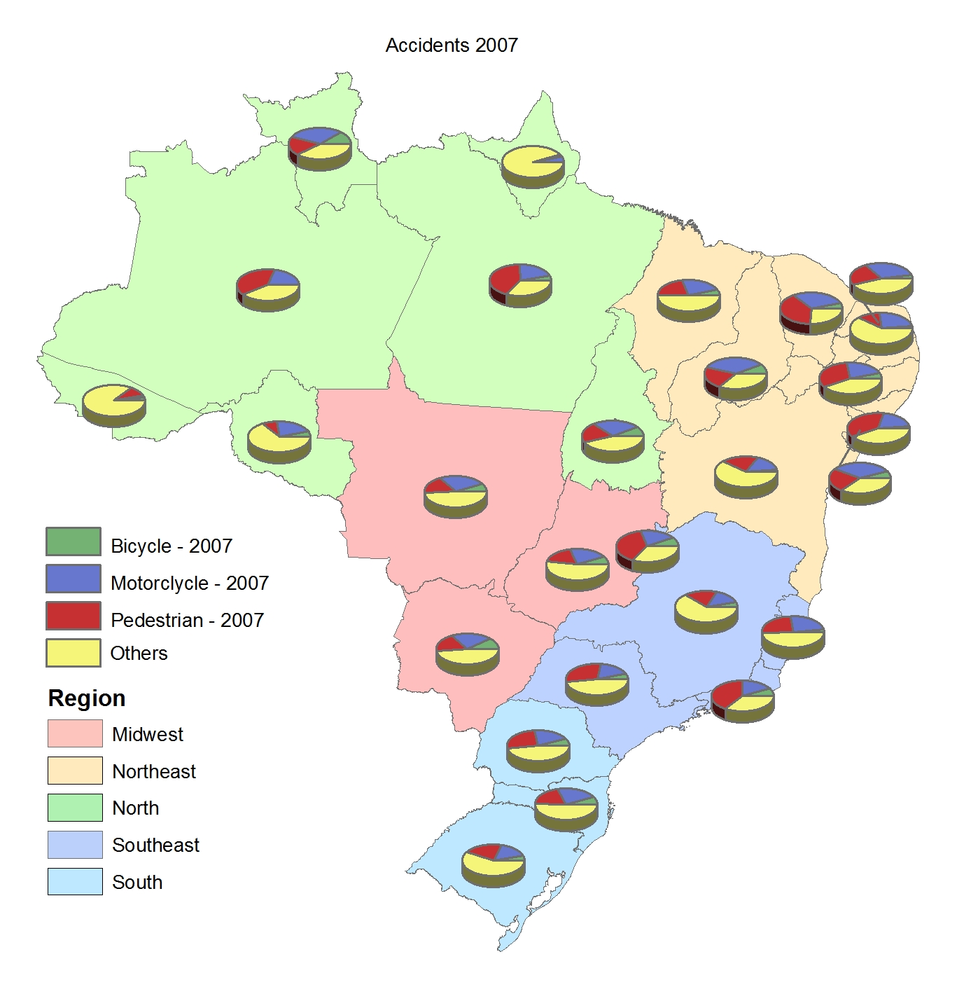
Vulnerable Users: Concept and Classes
Categories: pedestrians and cyclists
Risk groups: motorcyclists, others ...
Pedestrians: despite being a major problem for several decades, uneven pressure for their protection ... Ordinance is unclear and ineffective
Cyclists: not a manifested problem as a rule (small numbers in most cities) ... Clear pressure from “green” groups and politicians aiming at “politically correct” actions ... Few specific rules … No control …
Motorcyclists: the newer problem ... Strong increase in fleet: around 10% annually ... Even greater rate of increase in fatalities and injuries ... No specific rules … No control …

Slide 14
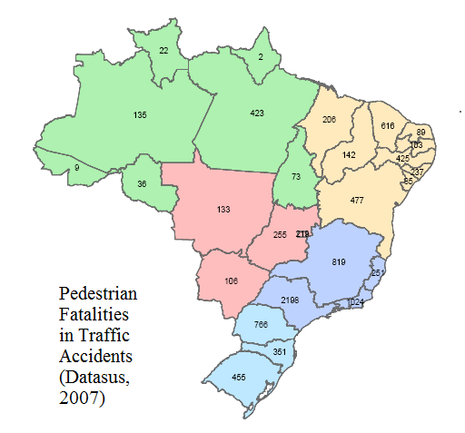
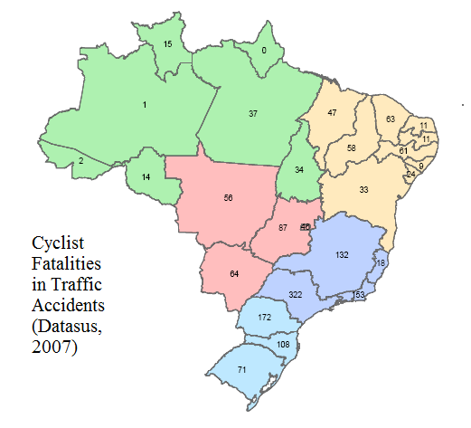
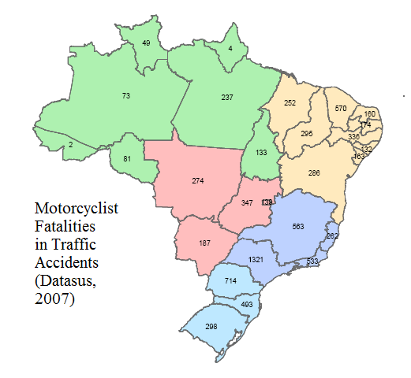
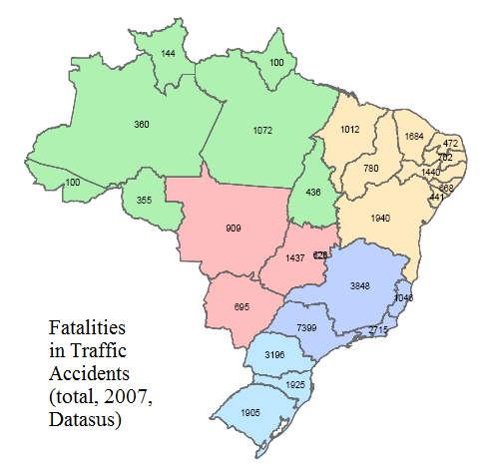

Slide 15
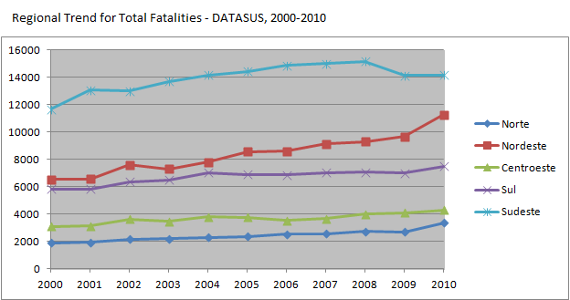
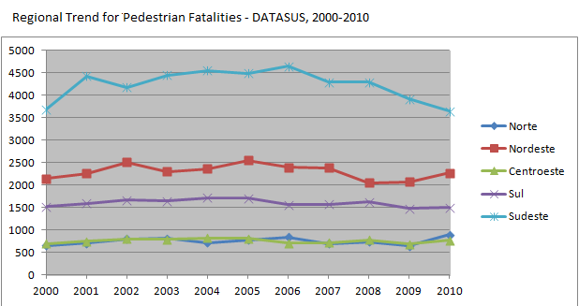
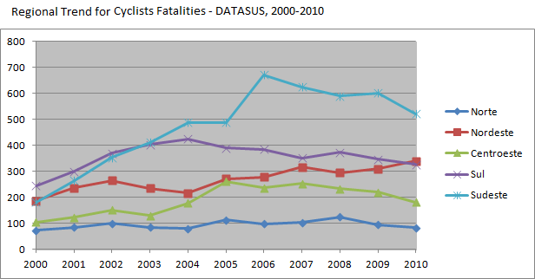
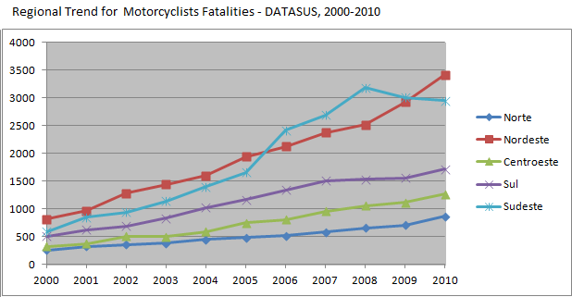
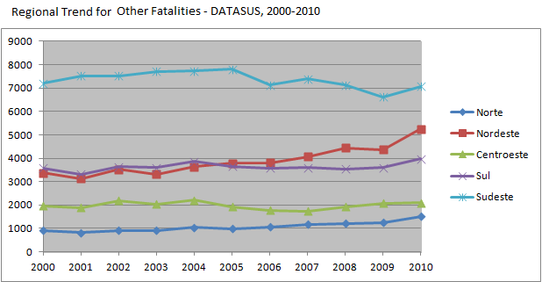
Vulnerable Users: is there a trend?
Major (recent) events: - none ... mostly external factors ...
Pedestrians: Ordinance is unclear and ineffective ... Isolated efforts on enforcing priority ... Lack of efforts on Public Education ... (un)Justice ...
Cyclists: Infra-structure is increasing (in plans, at least) ... No specific rules: cyclists as vehicles … need of space/segregation … Enforcement …
Motorcyclists: Strong debate (how much to restraint?) ... Isolated efforts to build Infra-structure to motorcycles (Sp) ... No specific rules: motos as autos (but there are proposals for changing laws) … Enforcement: a major problem …

Slide 16
road Safety Problem - city/Sp: POSITION OF VULNERABLE USERS AND THEIR accidents

Slide 17
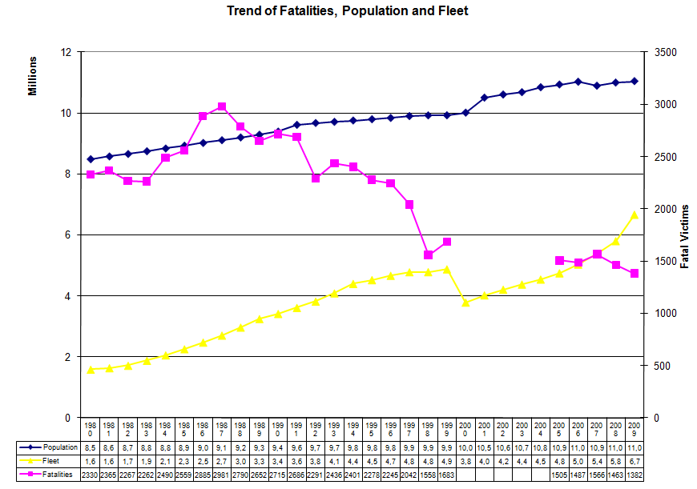
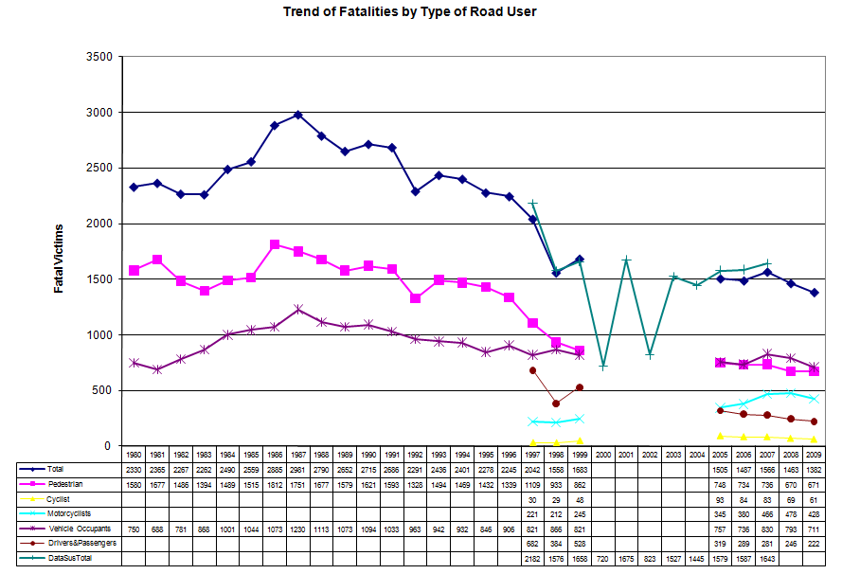
Accident Data: what about the City of Sp?
Major (recent) events: - 1992: mandatory use of safety belts and its enforcement; - dissemination of electronic enforcement ... - engagement in supporting the 1998 new code (CTB) ... - engagement in enforcement of drink&drive law ... - efforts in regulating moto services ... implementing moto-lanes ...
- recent efforts: promotion of bicycle infra, enforcement of ped priority ...
Own data collection system: using police reports and feeding RENAEST, also studies/investigation ...

Slide 18
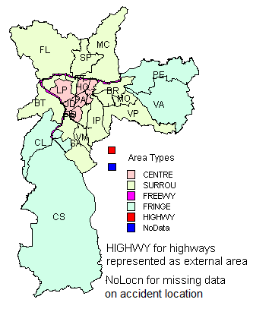
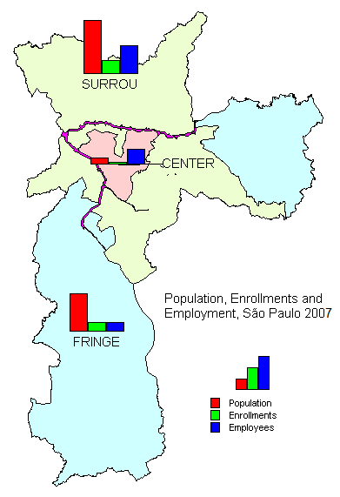
VRU Safety Problem in the City of Sp ...
General Accident Analysis: - a new database built on SAF ... - a new interpretative approach ... - a spatial disaggregation ... - an investigation on RIF data ...
All records (and the description of accidents available on SAF data) were screened for contributory factors for accidents and fatalities (the question is: will it work?)
Inspiration: TRACE-Traffic Accident Causation in Europe ... Revival of the interest in In-Depth Studies of Accidents ... Description of the full dynamic of events before, during and after the accident occurrence ...
Age Groups | From Age/To Age
Children | 0 | 15
Youngers | 16 | 24
Adults | 25 | 59
Olders | 60 | -
And gender
Periods of the Day | From Hour/To Hour
Late Night |  | 0 | 4
Early Morning |  | 4 | 6
Morning |  | 6 | 11
Mid Day |  | 11 | 14
Afternoon |  | 14 | 18
Early Night |  | 18 | 20
Night |  | 20 | 0
And week-ends

Slide 19
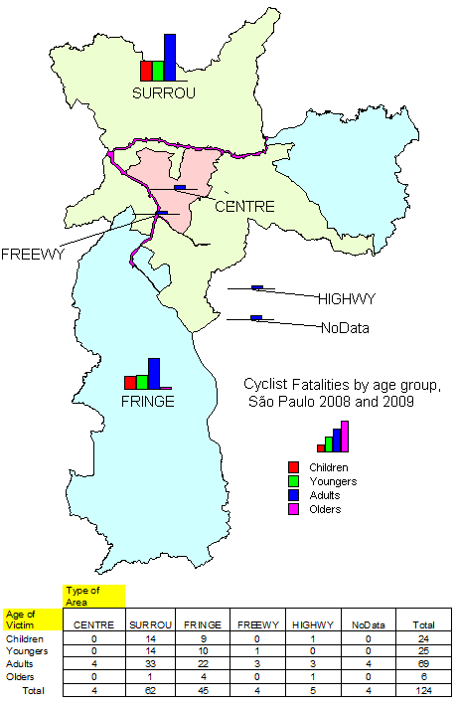
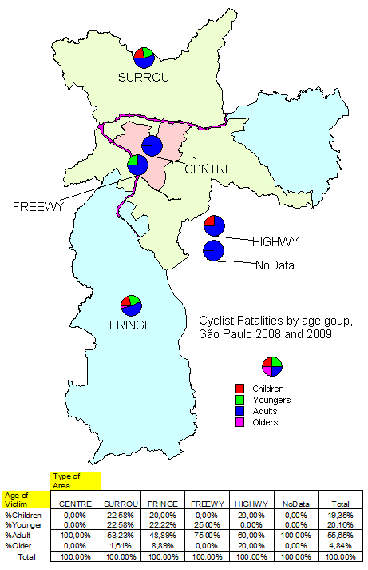
Incidence by Age Group
Peds: SURR/FRIN; similar patterns - mainly adults: 50%; 50% in pop - high risk for olders: 35%; 12%pop - relevant for children: 6%; ...
Bics: rare in CENT; small numbers ... - mainly adults&youngers: 57%&20% - high risk for children: 19%; 24%pop - irregular patterns (small numbers) ...

Slide 20
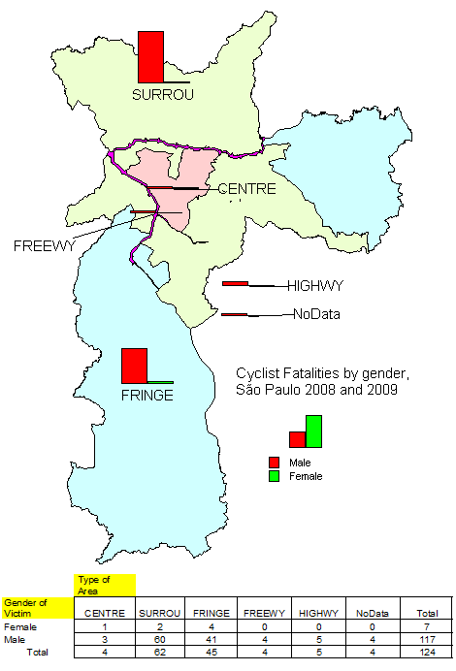
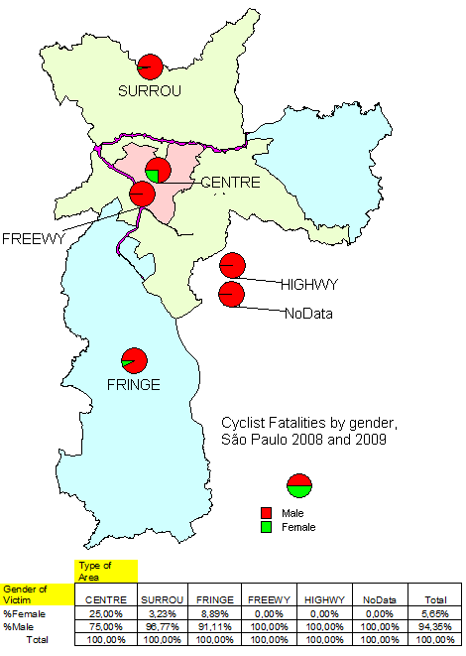
Incidence by Gender
Peds: activity areasXhigh speed roads - women more present: 29% not usual - even more in activity areas ... - peculiar: 50% olders for females
Bics: almost exclusively males - irregular pattern (small numbers) ... - relevant risk: women in FRIN ... - peculiar: 12% women for youngers

Slide 21
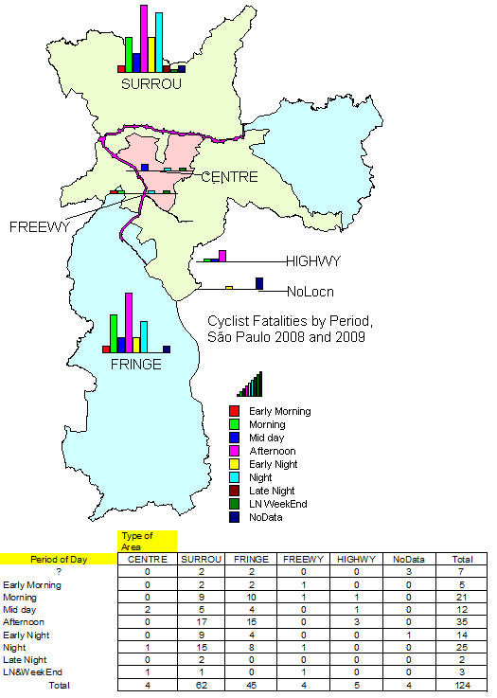
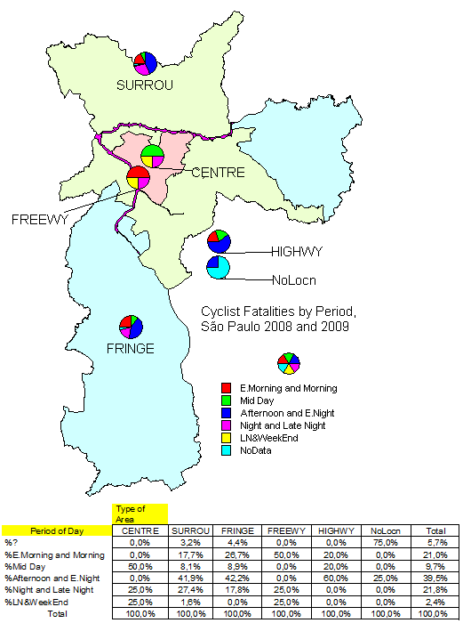
Incidence by Period of Day
Peds: peak&working hours; also night - similar patterns in activity areas - high speed roads: more in night, early morning, late night, weekend ...
Bics: pattern in SURR/FRIN only ... - similar to peds, even in weekends ... - small numbers in other areas

Slide 22
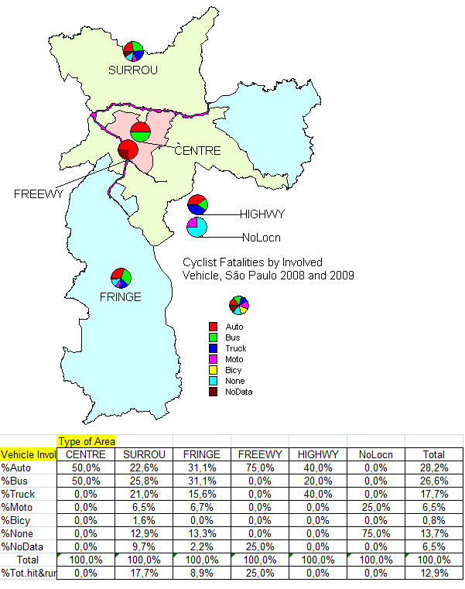
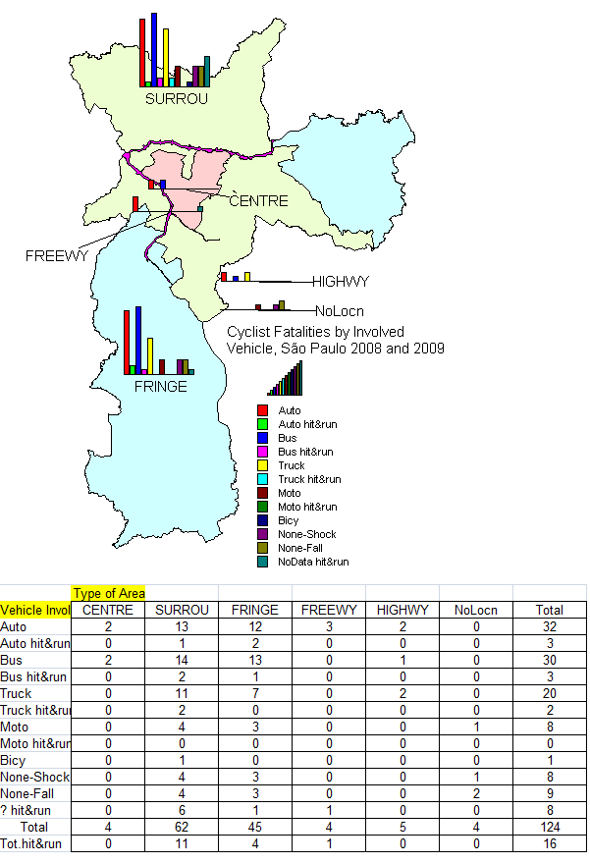
Incidence by Vehicle Involved
Peds: similar; follow share but - higher for motos: 19%; 12% fleet - higher for bus: 18% ... - very large: 27% vehicle evasion ...
Bics: pattern in SURR/FRIN only ... - higher presence of large vehicles: bus 28%; trucks 18% ... - none (falls, shocks): 14%

Slide 23
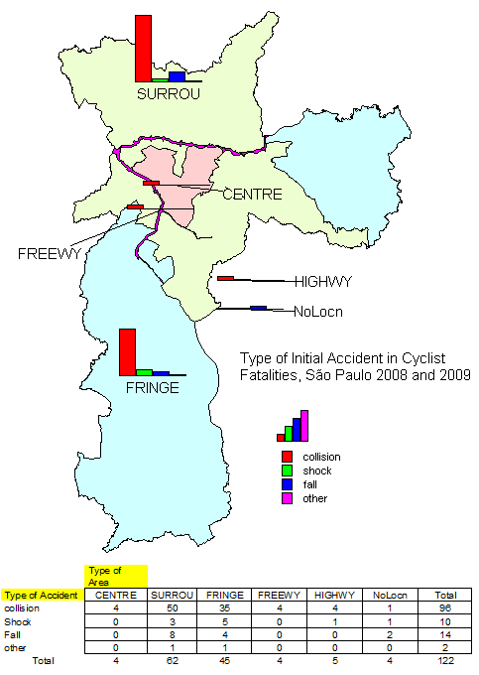
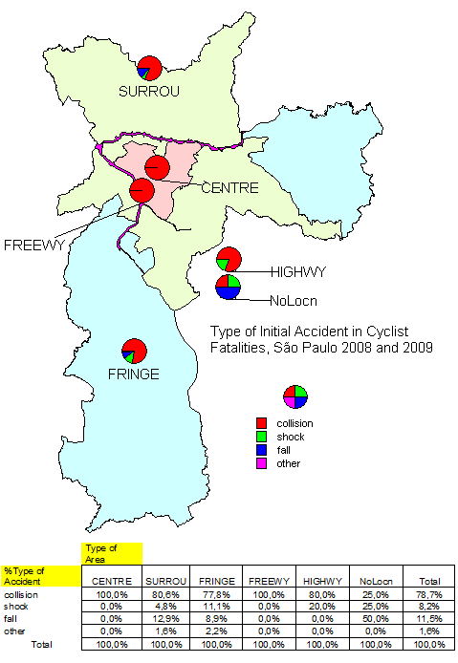
Incidence by Primary Accident
Peds: half lack of detail on hitting - when known: 41% in the road; 3% out the road (sidewalk/median ...) - patterns are similar, except FREE ...
Bics: pattern in SURR/FRIN only ... - initial collision in 79% ... - single vehicle in 20% ...

Slide 24
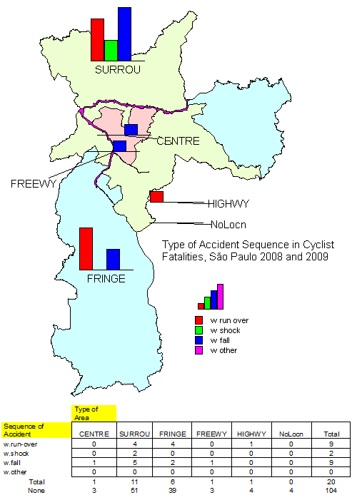
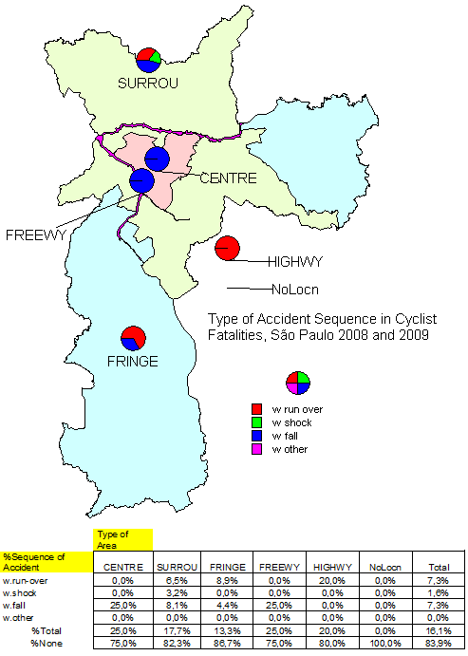
Incidence by Secondary Accident
Peds: overall, only in 9% ... - share of in road and out of road hitting in more similar: 2,7%&1,4%
Bics: overall, in 16% (more relevant) - relevant for severity: cyclist is run-over in 7%; more 7% with fall ...

Slide 25
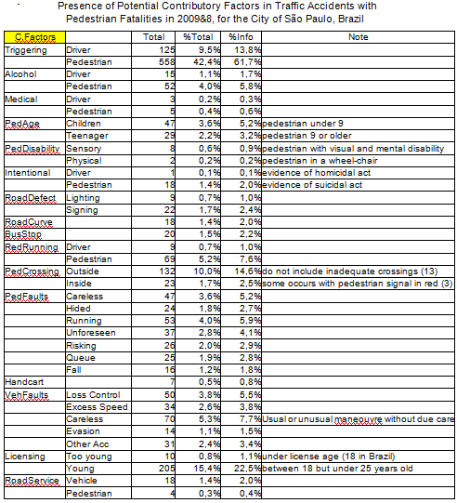
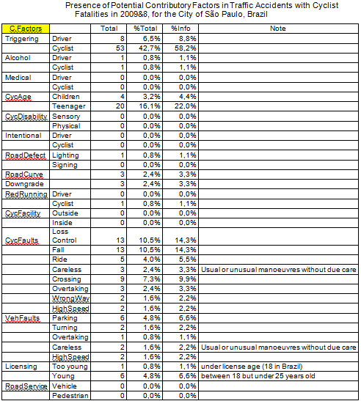
Factors in VRU Accs in the City of Sp ...
Types of Factors in Accidents: - Contributory or Contributing Factors: elements that are present in the pre-accident situation and that favor the future degradation of the safety in the situation ... - Initiating or Triggering Factors: elements directly generating the risk of accident (the rupture phase) ... - Aggravating Factors: elements that reduces the probability of avoiding the crash or that increase the probability of severe outcomes in the event of a crash...
Conclusion: even if interesting, data is clearly biased; the survivor view …

Slide 26
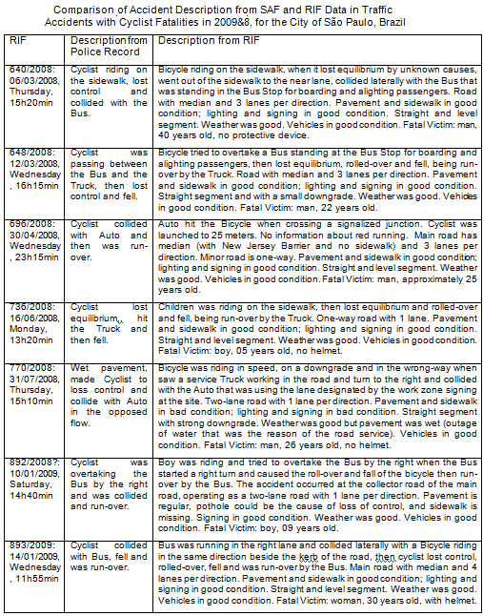
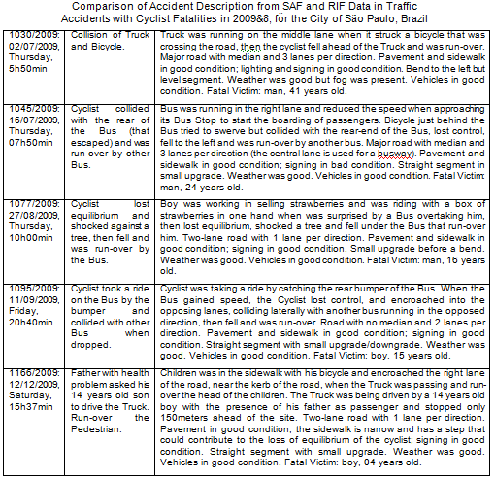
Factors in VRU Accs in the City of Sp ...
The data quality problem: - RIF-Accident Investigation Reports can overcome the biases in data? - Around 15% of fatal or serious accs examined by the RIF team, including field observation and interviews ...
Comparison of data analysis quotations revealed, initially, that most features were common and additions were minor (checking tasks of non-existent factors) but subsequent evaluation led to stress some major points (e.g. review the interaction with buses in the table)
But biases remain (designer view) including selection biases ... views!

Slide 27
road Safety Problem in Brazil: CONSTRAINTS AND dificulties …

Slide 28
What can make solutions to the Brazilian Traffic Safety Problem peculiar too?
That´s the question! A view ...
improve data on accidents for evaluation; also for analysis but it should be complemented ...
"enforcement" of technical standards in the road is a need; rethink division of road space, including sidewalks, medians; rethink signing for "new" rules ...
then other "enforcements" ... including judicial efforts and educational actions with content ... attention to aberrant behavior ... criticize "easy" policies (rules for others, "pure" spending ...)
poverties and inequalities ...
What are the options? Some points ...
Sp as example in current context; training for auditing for investigation; national effort is a major task ...
affirmative criteria for progressive improvement of infrastructure; needs of pedestrians; needs of cyclists, motorcyclists; special needs ... Old rules, new signing; until new rules ...
develop and test new technology ... video detection in accident scenes ...
favor integration ... and evaluate ... drinking/speeding/racing ... violations ... elevate requirements for public policies (full pre-test, targets, ...)
social policies are relevant too ...

