Slide 1
SaferBraIn Kick-off Meeting – Vulnerable Road Users and the Traffic Safety Problem in Brazil
Eng.Hugo Pietrantonio, D.Sc. Department of Transportation Engineering
Escola Politécnica – University of São Paulo, Brazil

Slide 2
SaferBraIn – Intro Brazil
Goal: - underline the basic features of the road safety problem in Brazil and its impact on vulnerable road users (VUsers) especially ...
- highlight points that can be peculiar to the brazilian problem or context, perhaps conditioning approaches that can be effective in reducing the current burden!
Basics on Institutional Setting
Basics on People and Safety
Vulnerable Road Users
Constraints and Difficulties

Slide 3
road Safety Problem in Brazil: basic information on The institutional setting

Slide 4
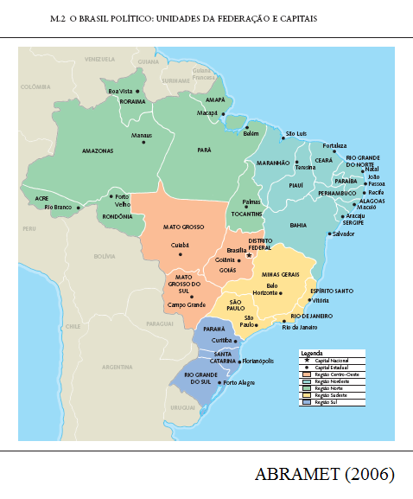
Brazil: Administration and Regions
Nominated as Federal Republic, i.e. a country constituted by states, but a highly centralized administration
- 1st exception: its major state ... State of São Paulo: 1/5 pop; 1/3 prod; -2nd exception: its major city ... City of São Paulo: 1/20 pop; 1/9 prod; - other exceptions: several capitals of states, medium-sized cities ...
Regional disparities are large: - North: large area, low density mainly undeveloped; Amazonia - Center(Mid)-West: similar; Cerrado - North-East: populated and poor - South-East: richiest (SP, RJ, ...) - South: second but similar ...

Slide 5
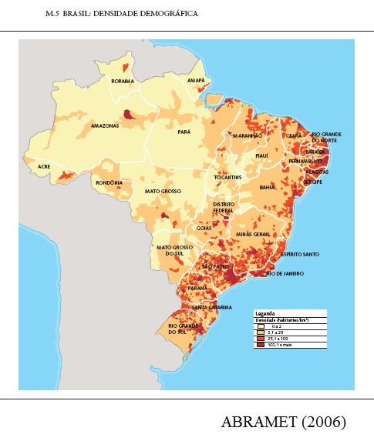
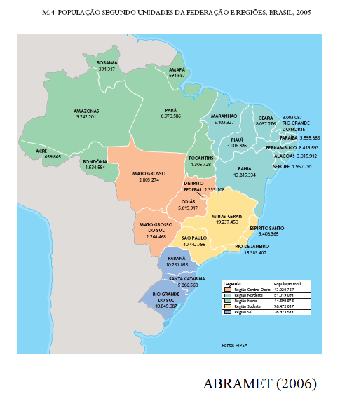
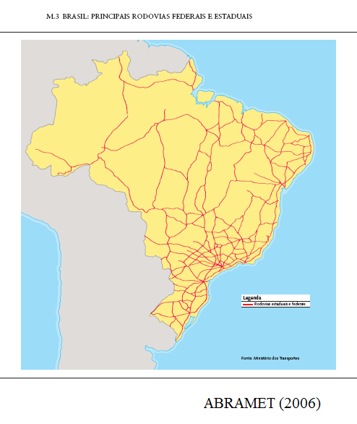
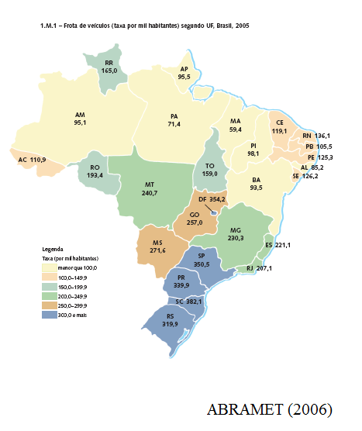
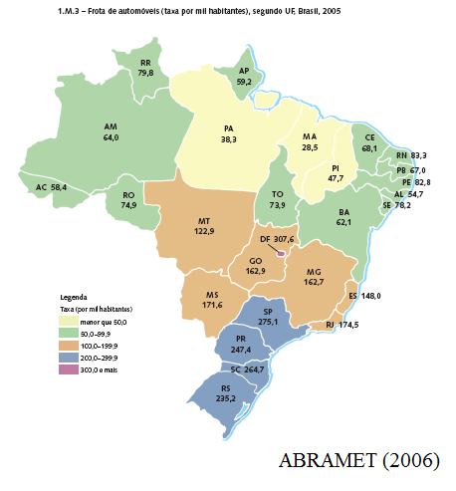

Slide 6
The National Traffic System (SNT-Sistema National de Trânsito)
Levels: Country, State, City ...
Areas: Traffic, Policing, Highway ...
Union: general rules and coordination; Contran-National Traffic Commission (under the Ministery of Cities ; before Ministery of Justice ... Transport ...)
State: licensing (drivers, vehicles)
Local bodies and Highway agencies: circulation on roads under their rules
Enforcement dispersed among levels and areas; exerted by own agents or delegated to other police bodies ...
Administrative justice also (JARIs ...)
Traffic | Policing | Highway | Other
Contran Denatran | PRF | DNIT ANTT | Justice
Cetran Detran | ... PMs ... PCs | DERs ARTEs | Justice
Local Authorities (*), GMs, ... (Sp: DSV, CET, ..., under SMT ...) |  |  | ...
JARI: 1st level of administrative recourse (2nd level of recourse is Cetran or Contran)
* Cities have to organize its bodies and gain approval from Cetrans, before acceptance * Complementary: CFCs (training of drivers), CMs (medical and psycho), OIs (inspection) ...
Norms:
highways
The judicial process is a major problem!
roads

Slide 7
road Safety Problem in Brazil: basic information on Roads and accidents

Slide 8
Data on Traffic Accidents and their Victims
Data sources: 3 main (weak) sources - from Police to DENATRAN, including PDO, injury and fatal accs, as gathered by SNT bodies ... - from Hospitals to DataSUS, only for injuries and fatalities ... - from Mandatory Insurance, when DPVAT coverage is reclaimed ...
Example: Fatalities in 2005 - Denatran: 26.409 deaths ... 25.342 - DataSus: 35.994 deaths ... 34.381 - SegDpvat: 50.953 deaths ... 39.179
For 'serious' bodies, local databases are usually much better and uniform
Renaest Denatran
DataSus M.Health
Insurance Lider
Traffic Bodies
Hospitals LegalMed
Insurance Agents
Police Records
Record of Inpatients
Reclaiming by Offended
Traffic Accident

Slide 9
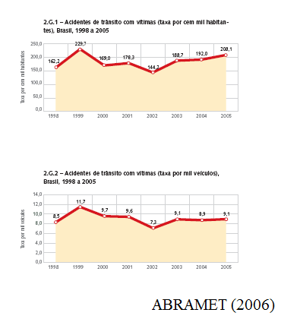
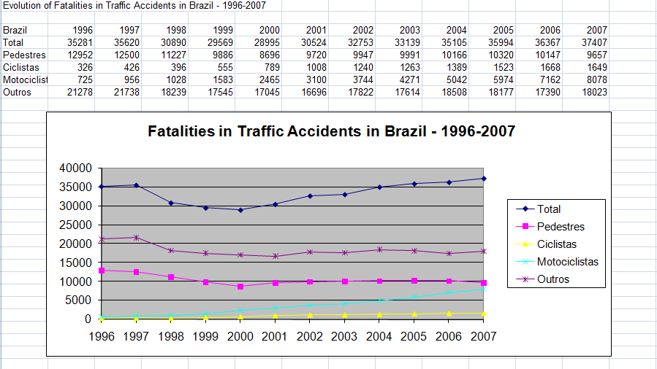
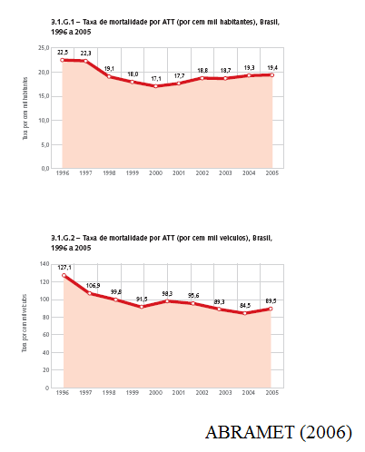
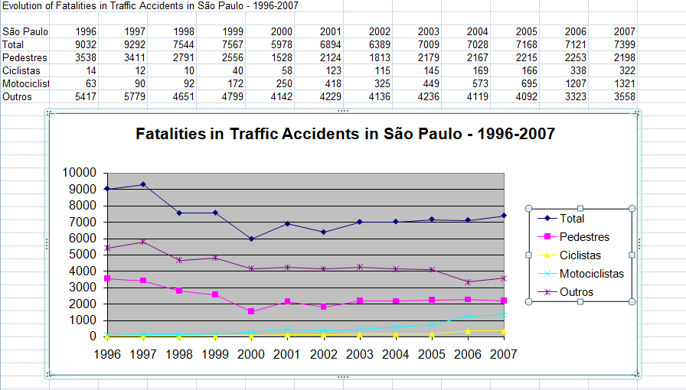
Accident Data: is there a trend?
Major (recent) events: - 1990 and after: dissemination of electronic enforcement ... - 1998: new code (CTB) effective ... (even if not fully efficient ... but progressive licensing, punctuation of driver offenses, increased fines, a national fund for traffic education ...) - 2005 and after: increased enforcement of drink&drive law ... (several trials ... the last in 2008 ...) - large pressure for bureacratic 'safety' actions (mandatory equipments, mandatory inspections, ... and other rent seeking biz ...)
Change of data collection: RENAEST

Slide 10
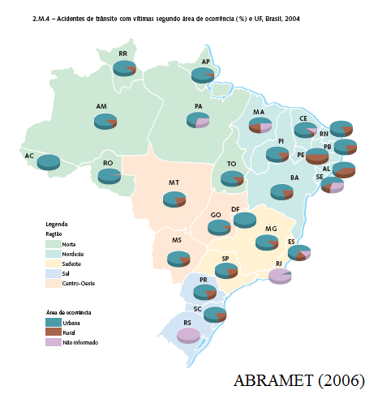
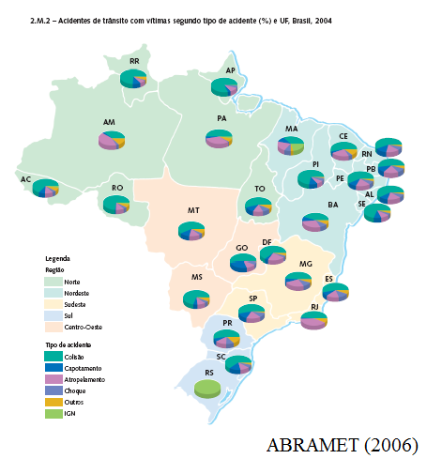
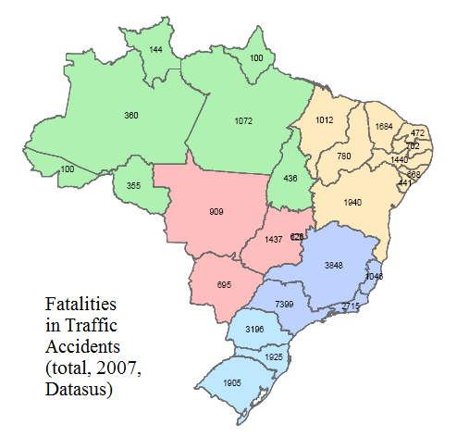

Slide 11
road Safety Problem in Brazil: POSITION OF VULNERABLE USERS AND THEIR accidents

Slide 12
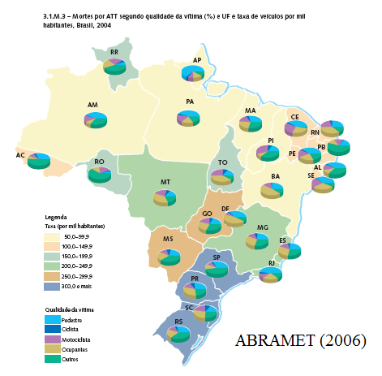
Vulnerable Users: Concept and Classes
Categories: pedestrians and cyclists for sure (perhaps motorcyclists ...)
Pedestrians: despite being the major problem for several decades, no clear pressure for their protection ... Ordinance is unclear and ineffective
Cyclists: not a manifested problem as a rule (small numbers in most cities) ... Clear pressure from “green” groups and politicians aiming at “politically correct” actions ... No specific rules … No control …
Motorcyclists: the newer problem ... Strong increase in fleet: around 10% annually ... Even greater rate of increase in fatalities and injuries ... No specific rules … No control …

Slide 13
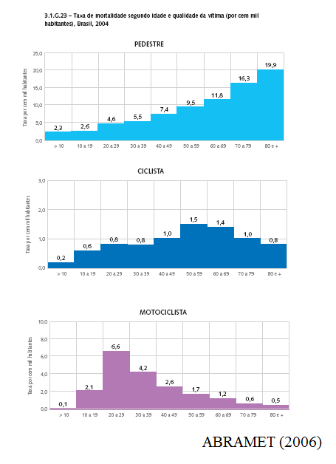
Vulnerable Users: is there a trend?
Major (recent) events: - none ... mostly external factors ...
Pedestrians: Ordinance is unclear and ineffective ... Isolated efforts on enforcing priority ... Lack of efforts on Public Education ... (un)Justice ...
Cyclists: Infra-structure is increasing (in plans, at least) ... No specific rules: cyclists as vehicles … need of segregation … Enforcement …
Motorcyclists: Strong debate (how much to restraint?) ... Isolated efforts to build Infra-structure to motorcycles (Sp) ... No specific rules: motos as if autos (but there are proposals for changing law) … Enforcement: a major problem …

Slide 14
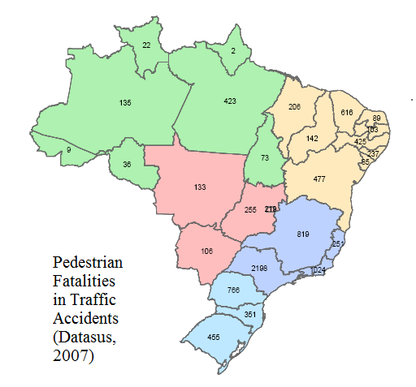
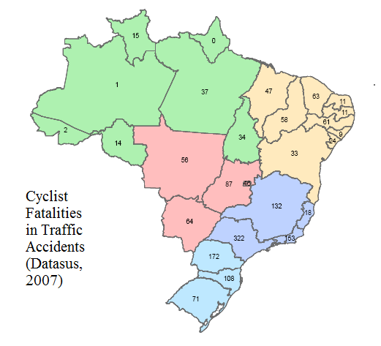
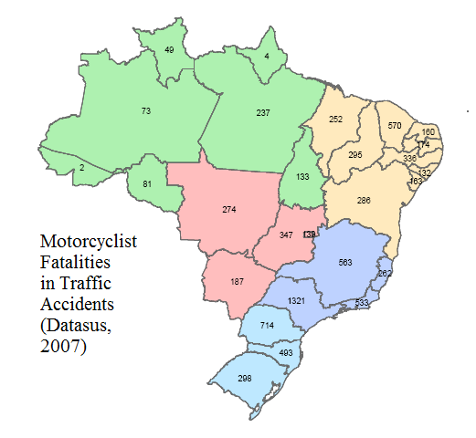
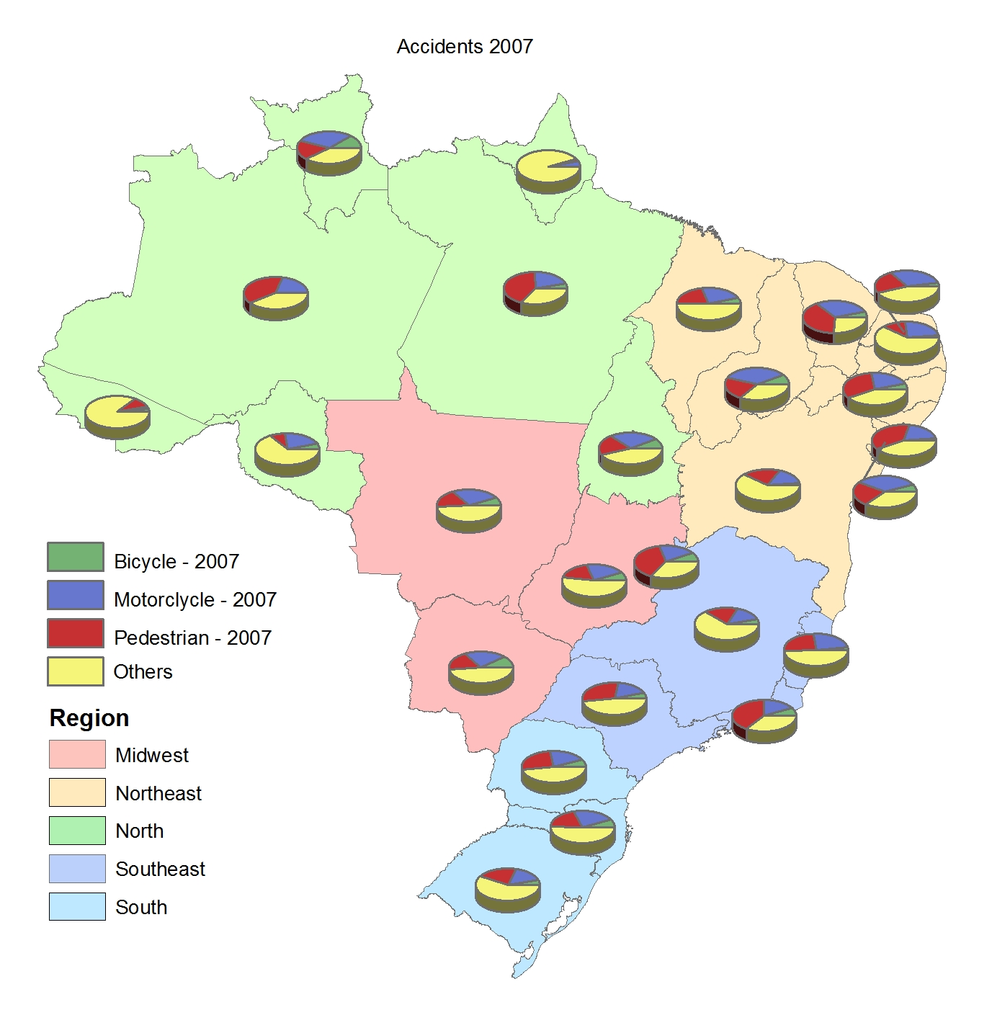
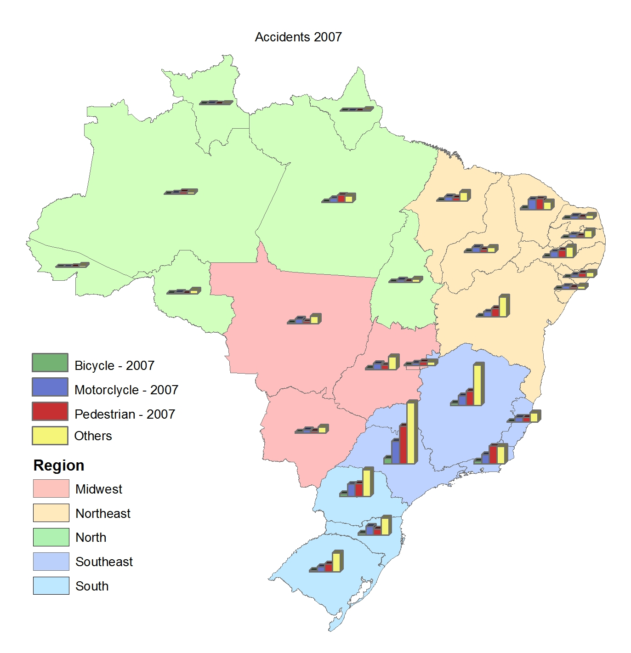

Slide 15
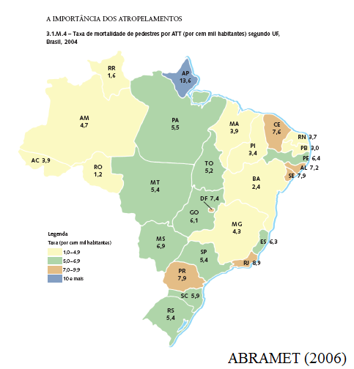
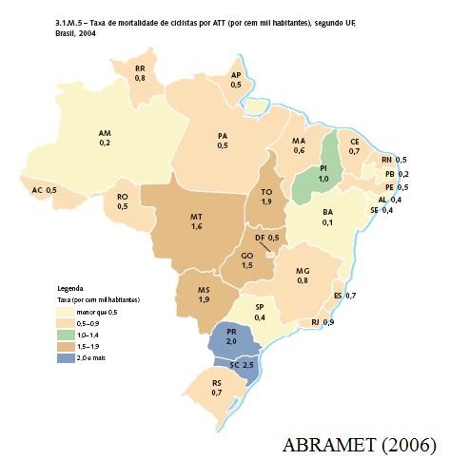
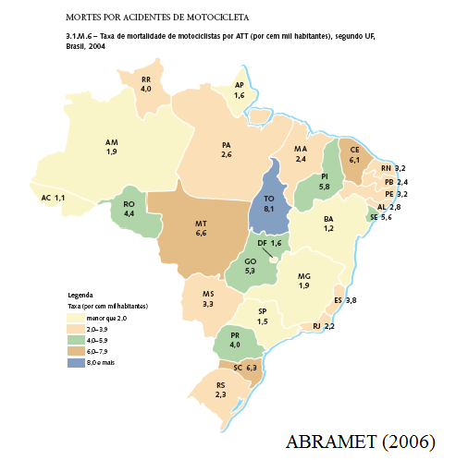
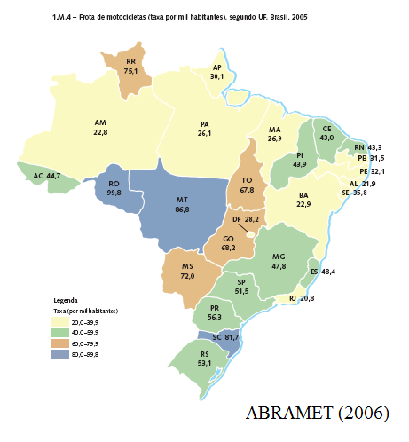

Slide 16
road Safety Problem in Brazil: CONSTRAINTS AND dificulties …

Slide 17
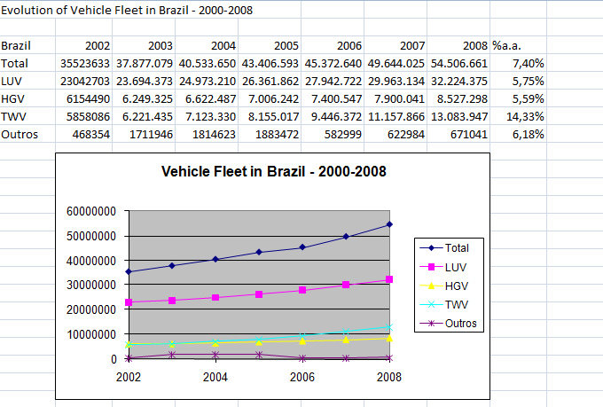
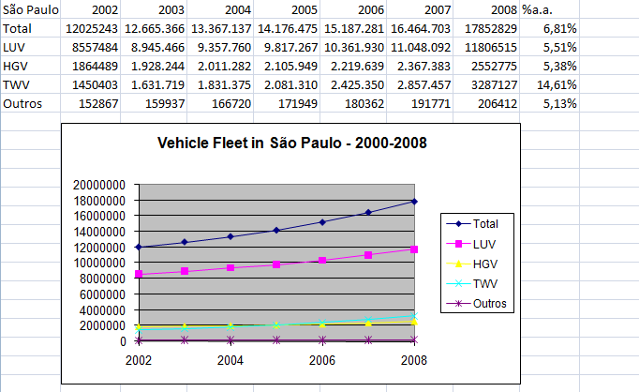
What can make the Brazilian Traffic Safety Problem peculiar?
Institutional differences are clear but their conditioning effect is not: - dependance on enforcement ... - dependance on physical actions (failure of the judicial system) ...
Dynamic factors are also a major difference: rate of chance is much higher ... new developments are widespread around cities and "rural" areas (major and minor ones) ...
Last, but not least (as usual): “poverties” are a constraint ... Including resources of agencies but mostly inequalities and their effects!

Slide 18
What can make solutions to the Brazilian Traffic Safety Problem peculiar too?
That´s the question!

